Slide 1
TECH
TALKS
Global Navigation and Positioning
Physical Layer Dynamics, Signal Structure, and Stochastic Estimation in Global Positioning Systems.
Presented by Akif Adas

Slide 2

Agenda
Introduction to GNSS
Position Navigation and Time Signal
PRN Codes
Position Solution
Maximum Likelihood Estimation
NonLinear Least Squares Estimation

Slide 3



The GNSS Landscape
Global Navigation Satellite Systems
GPS (United States)
GLONASS (Russia)
First Launch: 1978. Fully Operational: 1995. The baseline constellation for global L-band positioning. 31/38 Operational Satellites.
First Launch: 1982. Fully Operational: 1995. Unique FDMA architecture across multiple frequencies. 24/26 Operational Satellites.
Galileo (European Union)
BeiDou (China)
First Launch: 2011. Operational: 2016. High-integrity civilian signal utilizing BOC modulation. 26/34 Operational Satellites.
First Launch: 2000 (Regional). Global (BDS-3): 2020. Features high-inclination geostationary components. 46/60 Operational Satellites.

Slide 4

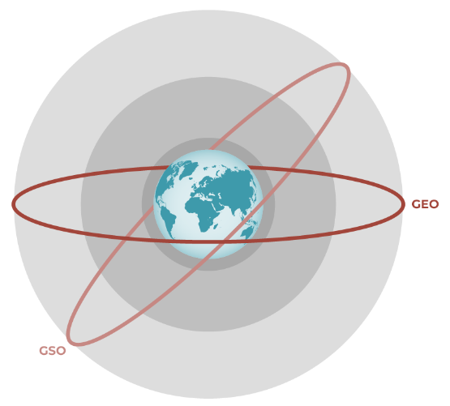

The Space Segment: MEO Dynamics
Orbital Mechanics
•
Altitude: ~20,200-29,000 km (MEO - Medium Earth Orbit).
•
Orbital Period: ~12 Sidereal Hours.
•
Speed: ~3.9 km/s.
Signal Propagation
Speed of light ($C$): 299,792.458 km/s.

Slide 5






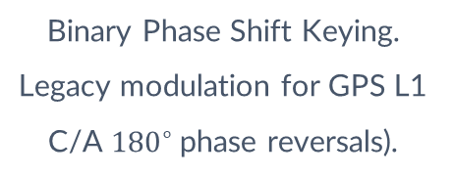
Signal Modulation Techniques
CDMA
BPSK
BOC
Code Division Multiple Access allows multiple satellites to share the same frequency band via orthogonal codes.
Binary Phase Shift Keying. Legacy modulation for GPS L1 C/A ${180}^{∘}$phase reversals).
Binary Offset Carrier. Splitting the signal energy to sharpen the correlation peak and mitigate multipath.

Slide 6
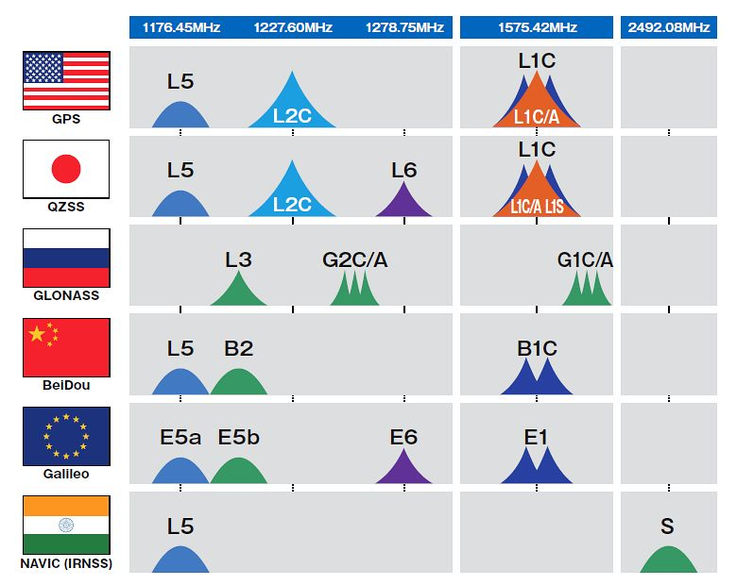
The GNSS Landscape

Slide 7
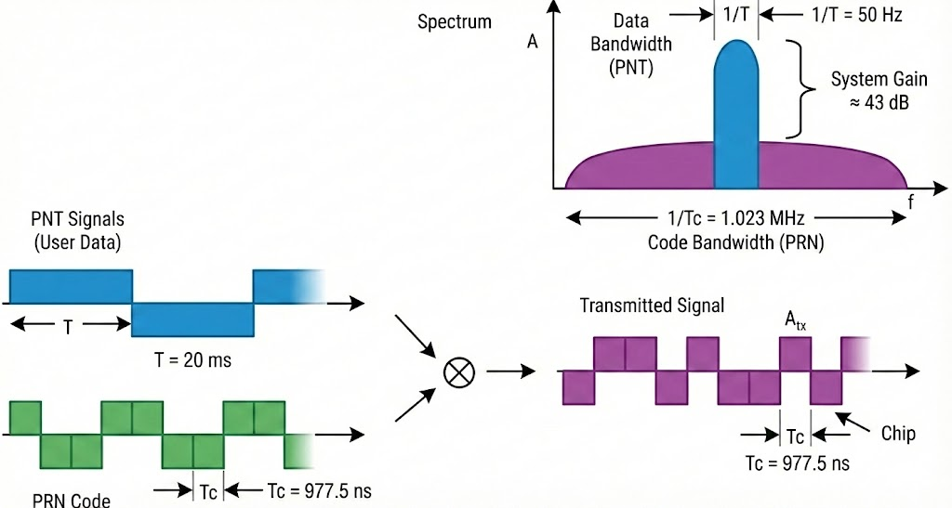
Code Division Multiple Access (CDMA)

Slide 8
Code Division Multiple Access (CDMA) - Generation

Slide 9
PRN Code Architecture
Signal Type | Code Length (Chips) | Chipping Rate | Repetition Period
GPS L1 C/A (Civil) | 1,023 | 1.023 MHz | 1 Millisecond
GPS P(Y) (Military) | ~6.18 Trillion | 10.23 MHz | 1 Week (266 day long)
Galileo E1 (Modern) | 4,092 | 1.023 MHz | 4 Milliseconds
Notes:
Ambiguity Resolution
In GPS, the receiver calculates distance by measuring the time shift of the code.
C/A Limitation: Because the C/A code repeats every 1 ms, the signal looks identical every 300 km (the distance light travels in 1 ms). The receiver has to use other methods to figure out which "millisecond" it is looking at.
P-Code Advantage: The P-code is so long that it never repeats during a single navigation session. Each segment of the code is unique, meaning there is zero "code phase ambiguity." Once you lock onto the P-code, you know exactly where you are in time relative to the satellite.

Slide 10

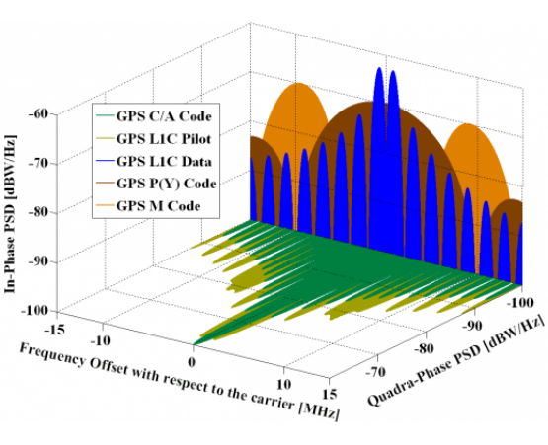

GPS L1 C/A: The Civil Standard
THE LOGIC
→
Modulation: Standard BPSK(1) on the L1 frequency (1575.42 MHz).
→
Chipping Rate: 1.023 million chips per second (Mcps).
→
Code Structure: Gold codes with 1,023 chips, repeating every 1 ms.
→
Design: Optimized for low cross-correlation and fast acquisition.
KEY ADVANTAGES
→
Rapid Acquisition: Short 1ms period allows for fast TTFF (Time To First Fix).
→
Universal Adoption: The global standard for over 4 billion civil devices.
→
Unencrypted: Free and open for global economic and scientific use.

Slide 11



GPS P(Y): Strategic Precision
THE LOGIC
→
Bandwidth: BPSK(10) modulation on both L1 and L2 frequencies.
→
Code Length: A massive ~2.35e14 chips, only repeating every 266 days.
→
Y-Code Encryption: W-code modulates the P-code to prevent spoofing.
→
Processing: Requires military cryptographic keys for decryption.
KEY ADVANTAGES
→
Decimeter Precision: 10.23 Mcps rate yields 10x higher timing accuracy.
→
Anti-Jamming: 20.46 MHz bandwidth provides high processing gain.
→
Anti-Spoofing: Encryption ensures the receiver locks to genuine signals.

Slide 12
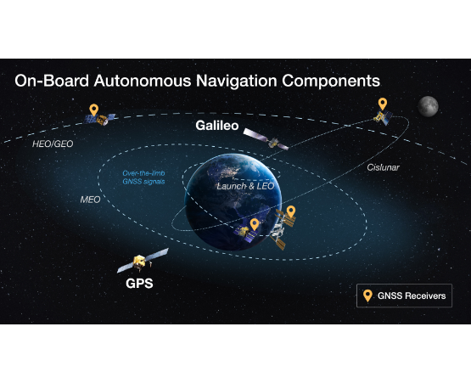
Galileo E1: Modern Evolution
THE LOGIC
→
Modulation: Advanced MBOC(6,1,1/11) to optimize spectrum usage.
→
Dual Channels: Split into Data (E1-B) and Pilot (E1-C) components.
→
Pilot Channel: Allows integration without navigation data bit-flips.
→
Secondary Codes: Improves robustness in weak signal environments.
KEY ADVANTAGES
→
Multipath Mitigation: BOC modulation filters out signal reflections.
→
High Sensitivity: Pilot tracking enables lock in dense urban canyons.
→
Interoperability: Shares spectrum with GPS L1 for dual-constellation fixes.

Slide 13
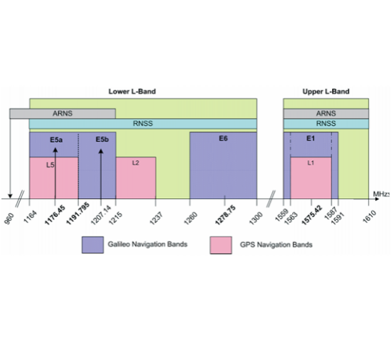


GNSS Signal Channel Architecture
In-Phase (I) Channel
The Data Channel. Contains the Navigation Message (Orbit parameters, clock corrections) modulated onto the carrier using BPSK or similar schemes.
Quadrature (Q) Channel
The Pilot Channel. A dataless signal component designed purely for high-precision ranging and robust tracking in challenging environments.

Slide 14

EXPLAINING THE PILOT SIGNAL
Dataless Tracking
Extended Integration
By removing the navigation data bits, there are no phase reversals every 20ms. This allows the receiver to maintain a phase lock without "cycle slips" caused by bit transitions.
Standard data signals limit coherent integration to ~20ms. Pilot signals allow 100ms+ integration, significantly boosting the Signal-to-Noise Ratio (SNR) for deep indoor or foliage tracking.
Secondary Codes
Robustness
Pilot signals often use tiered codes (Primary PRN + Secondary code). This structure improves synchronization and provides better protection against cross-correlation interference.
Used as the primary "anchor" for carrier phase tracking in modern receivers, specifically for GPS L5 (Q-channel) and Galileo E1 (C-channel).

Slide 15
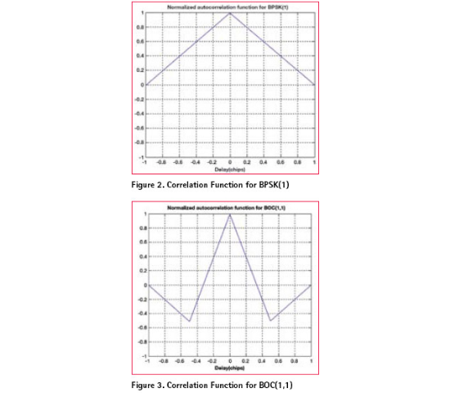


CORRELATION & TIME CALCULATION
PRN Matching: The receiver correlates the incoming signal with a local replica of the satellite's specific PRN code.
Peak Detection: The result is a triangle function; the apex represents the exact point of alignment (Code Phase).
Where is the pseudorange and is the speed of light.

Slide 16

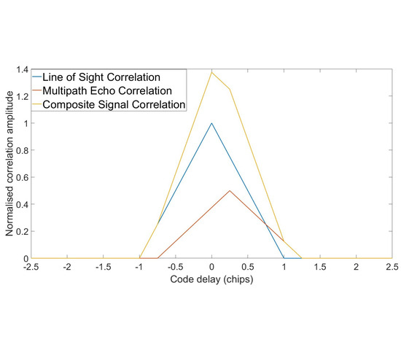

MULTIPATH & NLOS INTERFERENCE
Multipath Error
Reflected signals arrive with a delay, creating a secondary correlation peak. These peaks sum together, skewing the main triangle apex and causing range errors of 10–100m.
NLOS (Non-Line-of-Sight)
The direct signal is blocked; the receiver tracks only reflections. This produces a correlation peak that is shifted in time, introducing massive positive biases in position calculation.

Slide 17

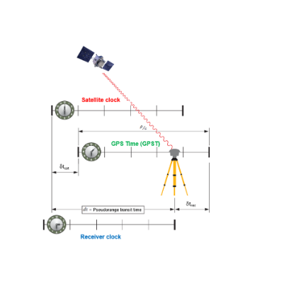

Pseudorange Determination
Calculating ToA
The receiver correlates the incoming signal with a local replica. The offset required to align the PRN codes determines the flight time.
The measurement is "Pseudo" because of un-synchronized receiver and satellite clocks.

Slide 18
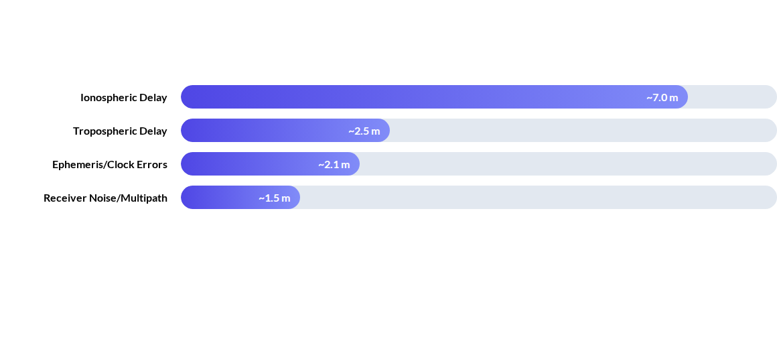
The Stochastic Error Budget
Relativistic Bias: Clocks gain ~38 microseconds per day due to gravitational potential and velocity differences.

Slide 19

The Navigation State Problem
4
Solving for (x, y, z, dt)
We solve the system of non-linear equations for the receiver's 3D coordinates and its internal clock bias.
Unknowns

Slide 20
Position problem definition

Slide 21

Estimation: MLE
MLE Foundation
Maximum Likelihood Estimation maximizes the probability of observing measurements under Gaussian noise assumptions. In GNSS, MLE and LS are equivalent for white noise.

Slide 22

Estimation: MLE
NLS Linearization
Non-Linear Least Squares uses Taylor expansion to linearize the range equations around an initial guess, iterating until convergence.

Slide 23
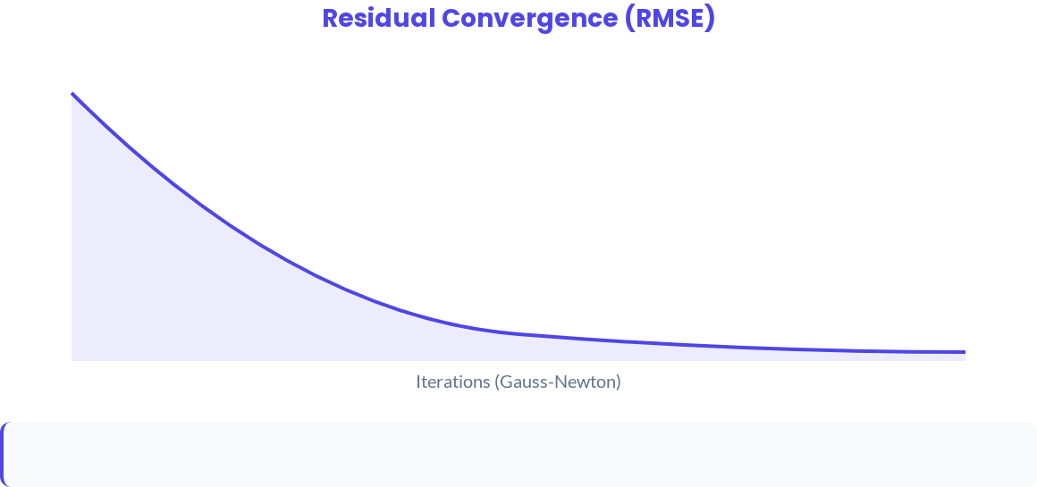

Iterative WNLS Refinement
Weighted Non-Linear Least Squares: Accounts for signal quality (SNR) and satellite elevation by applying a weight matrix $W$.

Slide 24
Technical Summary
A successful GNSS position solution depends on the precision of the local PRN correlation, the accuracy of the atmospheric delay models, and the robustness of the iterative estimator.
Questions?

